Slide 1
Mathematics the Preschool Way

Slide 2
Principles of Mathematics
The six Principles for school mathematics address overarching themes:
Equity. Excellence in mathematics education requires equity—high expectations and strong support for all students.
Curriculum. A curriculum is more than a collection of activities: it must be coherent, focused on important mathematics, and well articulated across the grades.
Teaching. Effective mathematics teaching requires understanding what students know and need to learn and then challenging and supporting them to learn it well.
Learning. Students must learn mathematics with understanding, actively building new knowledge from experience and prior knowledge.
Assessment. Assessment should support the learning of important mathematics and furnish useful information to both teachers and student.
Technology. Technology is essential in teaching and learning mathematics; it influences the mathematics that is taught and enhances students' learning.

Slide 3
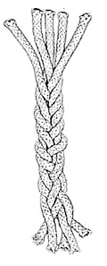
When it comes to math, what do children need to know?
5 Content Strands
Numbers & Operations
Algebra
Geometry
Measurement
Data Analysis & Probability
5 Process Strands
Problem Solving
Reasoning & Proof
Communication
Connections
Representations
Notes:
In 2000, the National Council of Mathematic Teachers identified a common set of 10 math standards that describe the growth of mathematical knowledge across grades Prek-12.
What all children need to know about math can be divided into 10 areas or “strands.”
Five of these strands identify math content children should learn.
The other five strands identify ways children will acquire and apply math content.
Later today, you will see that these 10 math strands form the foundation for Kentucky’s Early Childhood Standards (KYECS) and the Kindergarten Kentucky Core Academic Standards (KCAS). But first, we want to spend some time getting to know these 10 strands and what they should like in preschool and kindergarten.
Background for Facilitators:
In 2000, the National Council of Mathematic Teachers published a document called the Principles and Standards for School Mathematics that identified a common set of 10 math standards that describe the growth of mathematical knowledge across grades Prek-12.
In 2010, building on the work done by NCTM, the Common Core State Standards Initiative published (a state-led effort coordinated by the National Governors Association Center for Best Practices (NGA Center) and the Council of Chief State School Officers), a set of ELA and Math standards that define the knowledge and skills students should have within their K-12 education careers so that they will graduate high school able to succeed in entry-level, credit-bearing academic college courses and in workforce training programs.
In 2010, KY became the 1st state to adopt the ELA and Math Common Core Standards which have now been incorporated into Kentucky’s Core Academic Standards (KCAS).
Graphic source: http://mason.gmu.edu/~jsuh4/teaching/strands.htm

Slide 4
When Math Content is Most Likely to Occur
Other
Small group instruction (10%)
Free choice/ center time (30%)
Reported in Mathematics Learning in Early Childhood: Paths Toward Excellence and Equity (National Academy Press, 2009)
Notes:
In preschool, math content is most likely to occur during whole-group activities (~50%). Free choice/center time is the 2nd most common time when children are likely to engage in math activities (~30%). Time spent in math-related small group instruction comes in as a distant third (~10%). Routines, meal and snack times could be great opportunities to intentionally incorporate math concepts. Unfortunately, these studies reported that few preschool or kindergarten teachers appeared to take advantage of the learning opportunities that arose during transitional periods and they didn’t use strategies for getting the most out of classroom time.
Preschool children spend a very small portion of their day engaged in math activities and that the majority of those math activities are likely to take place in whole-group activities.
They also found that teachers were more likely to embed math content into other activities (e.g., art, music and fine motor) than they were to include math-specific activities.

Slide 5
Math Topics Focused on in Preschool
Counting (67%)
Sorting (60%)
Numeral recognition (51%)
Patterning (46%)
Number concepts (34%)
Spatial relations (32%)
Making shapes (16%)
Measuring (14%)
Reported in Mathematics Learning in Early Childhood: Paths Toward Excellence and Equity (National Academy Press, 2009)
Notes:
It should come as no surprise that counting received the most attention. And you can see on your screen that teachers were least likely to focus on concepts related to geometry and measurement.

Slide 6
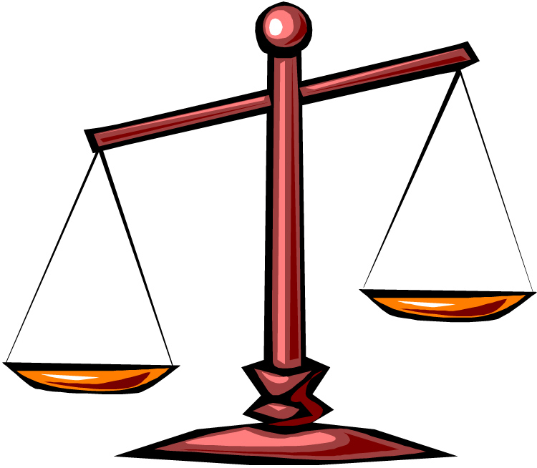
Math-Related Teacher Talk (Preschool)
Scaffolding
Conversational/interactive
Focused on understanding & problem solving
Encouragement, praise
Instructions
Closed-ended questions
Reported in Mathematics Learning in Early Childhood: Paths Toward Excellence and Equity (National Academy Press, 2009)
Notes:
Studies show that children exposed to more math talk have greater gains in math knowledge. Yet, a New Jersey study found that teachers provided little support for children’s mathematical skill development and seldom used math terminology. The NCEDL preschool study found similar results. Preschool math teacher-talk was more likely to involve encouragement and praise, giving instructions, asking questions with one correct answer, etc. Teachers were less likely to use language that scaffolded children’s math learning. In other words, children were less often exposed to math instruction that was conversational, interactive or focused on understanding and problem solving. It appears that preschool teachers often taught math in a way that focused on student performance of a discrete skill or display of factual knowledge.
Nancy – Is that a nice way of saying that children were exposed to very basic rote concepts like counting, number recognition and the names of shapes?
Kathy – Yes Nancy, mathematics seems to be seriously overlooked in preschool classrooms even when teachers say that it is important and that they teach it in preschool and kindergarten classrooms. Many are adept at preparing the physical environment that includes mathematics, but not in actually teaching mathematics.

Slide 7
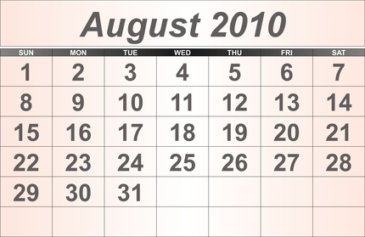
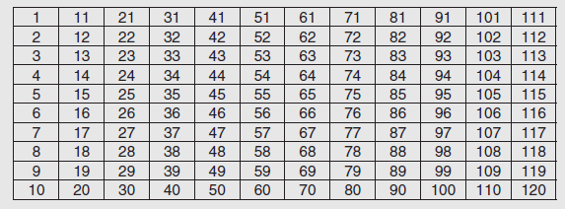
Calendar Time Does Not Emphasize Foundational Mathematics
Notes:
The most prominent generalized strategy was calendar-related activities, which occurred on a daily basis in over 90 percent of the kindergarten classrooms surveyed.
Mathematics educators do not consider most calendar activities to be useful early childhood mathematics instruction and have serious questions about the efficacy of “doing the calendar” every day. “Doing the calendar” is not a substitute for teaching foundational mathematics.
While the calendar may be useful in helping children begin to understand general concepts of time, such as “yesterday” and “today” or plan for important events like field trips or visitors, these are not core mathematical concepts.
The main problem with the calendar is that the groups of seven days in the rows of calendars have no useful mathematical relationship to the number 10, the building block of our number system. Calendar time does not help children learn the base 10 patterns. The reality is that time spent on calendar would be better used on more effective mathematics teaching and learning experiences.

Slide 8
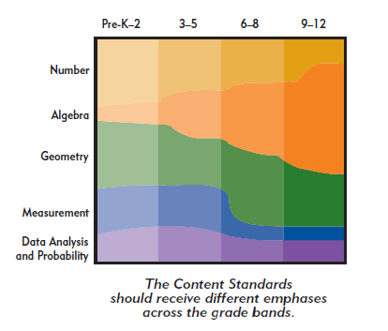
Notes:
Explain that this graph shows how different content strands should receive different levels of emphasis across the grade bands.
Ask several people to share what areas of math they are most likely to focus on. Relate that to the fact that in preschool-through second grade, the 3 math content strands that should get the most focus are: numbers and operations; geometry, and measurement. Point out that while they shouldn’t get as much attention, algebra and data analysis should also be addressed in preschool through 2nd grade.
NOTE: This graph is included in the handout that they just read but unless you print it in color, it is difficult to see the distinction among math strands at each grade level.
Source: Executive Summary – Principles and Standards for School Mathematics (NCTM)

Slide 9
Recommendations Within the Classroom
1. Enhance children’s natural interest in mathematics and their disposition to use it to make sense of their physical and social worlds.
2. Build on children’s experience and knowledge, including their family, linguistic, cultural, and community backgrounds; their individual approaches to learning; and their informal knowledge.
3. Base mathematics curriculum and teaching practices on knowledge of young children’s cognitive, linguistic, physical, and social emotional development.
4. Use curriculum and teaching practices that strengthen children’s problem-solving and reasoning processes as well as representing, communicating, and connecting mathematical ideas.

Slide 10
Recommendations Continued
5. Ensure that the curriculum is coherent
and compatible with known relationships
and sequences of important mathematical
ideas.
6. Provide for children’s deep and sustained
interaction with key mathematical ideas.
7. Integrate mathematics with other activities
and other activities with mathematics.

Slide 11
Recommendations
8. Provide ample time, materials, and teacher
support for children to engage in play, a
context in which they explore and manipulate mathematical ideas with keen interest.
9. Actively introduce mathematical concepts,
methods, and language through a range
of appropriate experiences and teaching
strategies.

Slide 12
Recommendations
10. Support children’s learning by thoughtfully and continually assessing all children’s mathematical knowledge, skills, and strategies.
Notes:
Number cards

Slide 13
Taking A Closer Look
Geometry
Algebra
Measurement
Number & Operations
Data Analysis & Probability
Notes:
Preschool curriculum focal points Handout
Ten frames

Slide 25
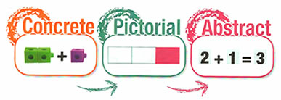
Concrete Pictorial Abstract Method

Slide 26
Bridging: Problem Solving in Mathematics
1.Observer
2. Validator
3. Participant/converser
4. Extender
5.Problem initiator
6. Role Model
7.Instructor
8.Manager/organizer/provider
Notes:
Make 10

Slide 27
Intentional Mathematics Teaching Strategies
Number and Operations
Count sets of objects
Solve number problems
Play games that require them to move one, two or three spaces
Compare the number in two sets of objects
“see” small groups of numbers
write symbols for number quantities

Slide 28
Intentional Mathematics Teaching Strategies
Geometry and Spatial Sense
manipulate shapes
create structures or make pictures using shapes
name or label shapes during class activities and in their environments
experiment with shape attributes
describe the attributes of shapes
work puzzles
use geometric vocabulary appropriately
work in the Block Area
move shapes to fit into a confined space

Slide 29
Intentional Mathematics Teaching Strategies
Measurement
use measurement tools
try to fit objects into specific spaces
compare the size of objects
use measurement vocabulary
pour water or rice into containers
use the term bigger to describe something

Slide 30
Intentional Mathematics Teaching Strategies
Patterns (Algebra)
create patterns using objects
Identify patterns in their environment
follow movement patterns
see patterns in stories or verses
can begin to use more complex patterns
add to patterns created or discovered by other students
predict what will happen next in the class schedule
suggest unusual patterns
use words to describe patterns or changes
observe changes in classmates, classroom animals, or classroom plants

Slide 31
Intentional Mathematics Teaching Strategies
Data Analysis
put objects in piles or groups
talk about the class charts or graphs
create art projects
play classification games
identify objects by color, size , or shape
participate in class routines

Slide 32
Quote
Should we immediately correct young children’s misconceptions about mathematics? Can we expect all children to solve problems in identical ways? Should we expect all the young children in a group to “get it” at the same time?
Notes:
Answer is NO …as teachers we need to remember that young children construct mathematical understanding in different ways at different times and with different materials. Our job is to provide an enviorment in which all children can learn mathematics (6-8). The Young Child and Mathematics Copely (2000)

Slide 33
NAEYC and NCTM 2002
Positive experience with using mathematics to solve problems help children to develop dispositions such as curiosity, imagination, flexibility, inventiveness, and persistence that contribute to their future success in and out of school.

