Slide 1
PBIS in The Kindergarten Setting
Creating Positive and Productive Early Childhood Environments

Slide 2
Norms

Slide 3
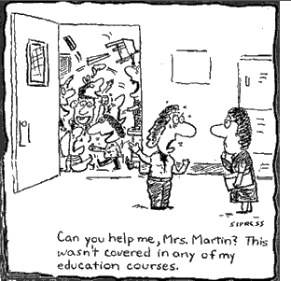

Slide 4
Purpose
I can develop and implement at least 2 strategies that will improve the behavior of students immediately.
I can utilize the resources provided to help students to be successful

Slide 5
Daily Schedule
AM: Classrooms that Support Positive Behaviors
  Positive Behavior Interventions and Supports (PBIS) Overview
  Implementation Checklist
  Developing Class-wide Interventions
  Lunch (11:00-12:15)
PM: Systems of interventions for Intensive Behaviors
  Flowchart
  Aims Web

Slide 6
Activity 1
Talk at your table group and discuss the top three problem behaviors in your classroom setting
  Chart Paper
Share out

Slide 7

MAC – Group Activity
Movement
Activity
Conversation
Level 2

Slide 8
Time your activities
www.online-stopwatch.com

Slide 9
Positive Behavior Interventions and Supports (PBIS)
Kentucky Background – Task Force 1996-97
Origins of PBIS

Slide 10
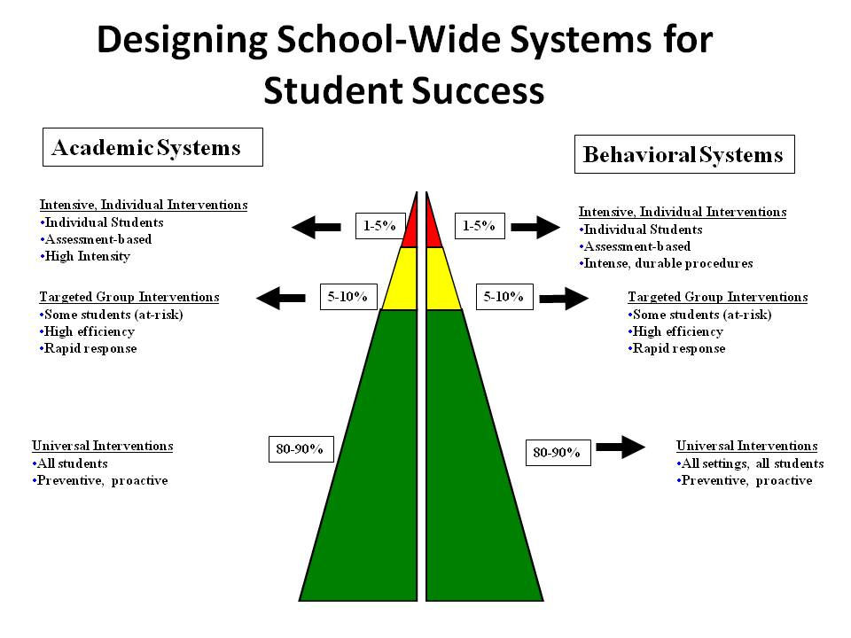
PBIS
Positive Behavior Interventions and Supports
  Behavior RtI

Slide 11
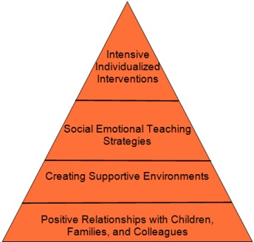

Slide 12
Universal Interventions
Meets the needs of ALL students
Reduces the number of Targeted and Intensive students
Often the basis of effective intensive interventions
WARNING!!!! DOES NOT ELIMINATE INTENSIVE STUDENT MISBEHAVIORS!

Slide 13
Universal Interventions: Classroom Management
5 Critical Features of Classroom Management
Maximize structure in your classroom.
Post, Teach, Review, Monitor, and Reinforce a small number of positively stated expectations.
Actively engage students in observable ways.
Establish a continuum of strategies to acknowledge appropriate behavior.
Establish a continuum of strategies to respond to inappropriate behavior.

Slide 14
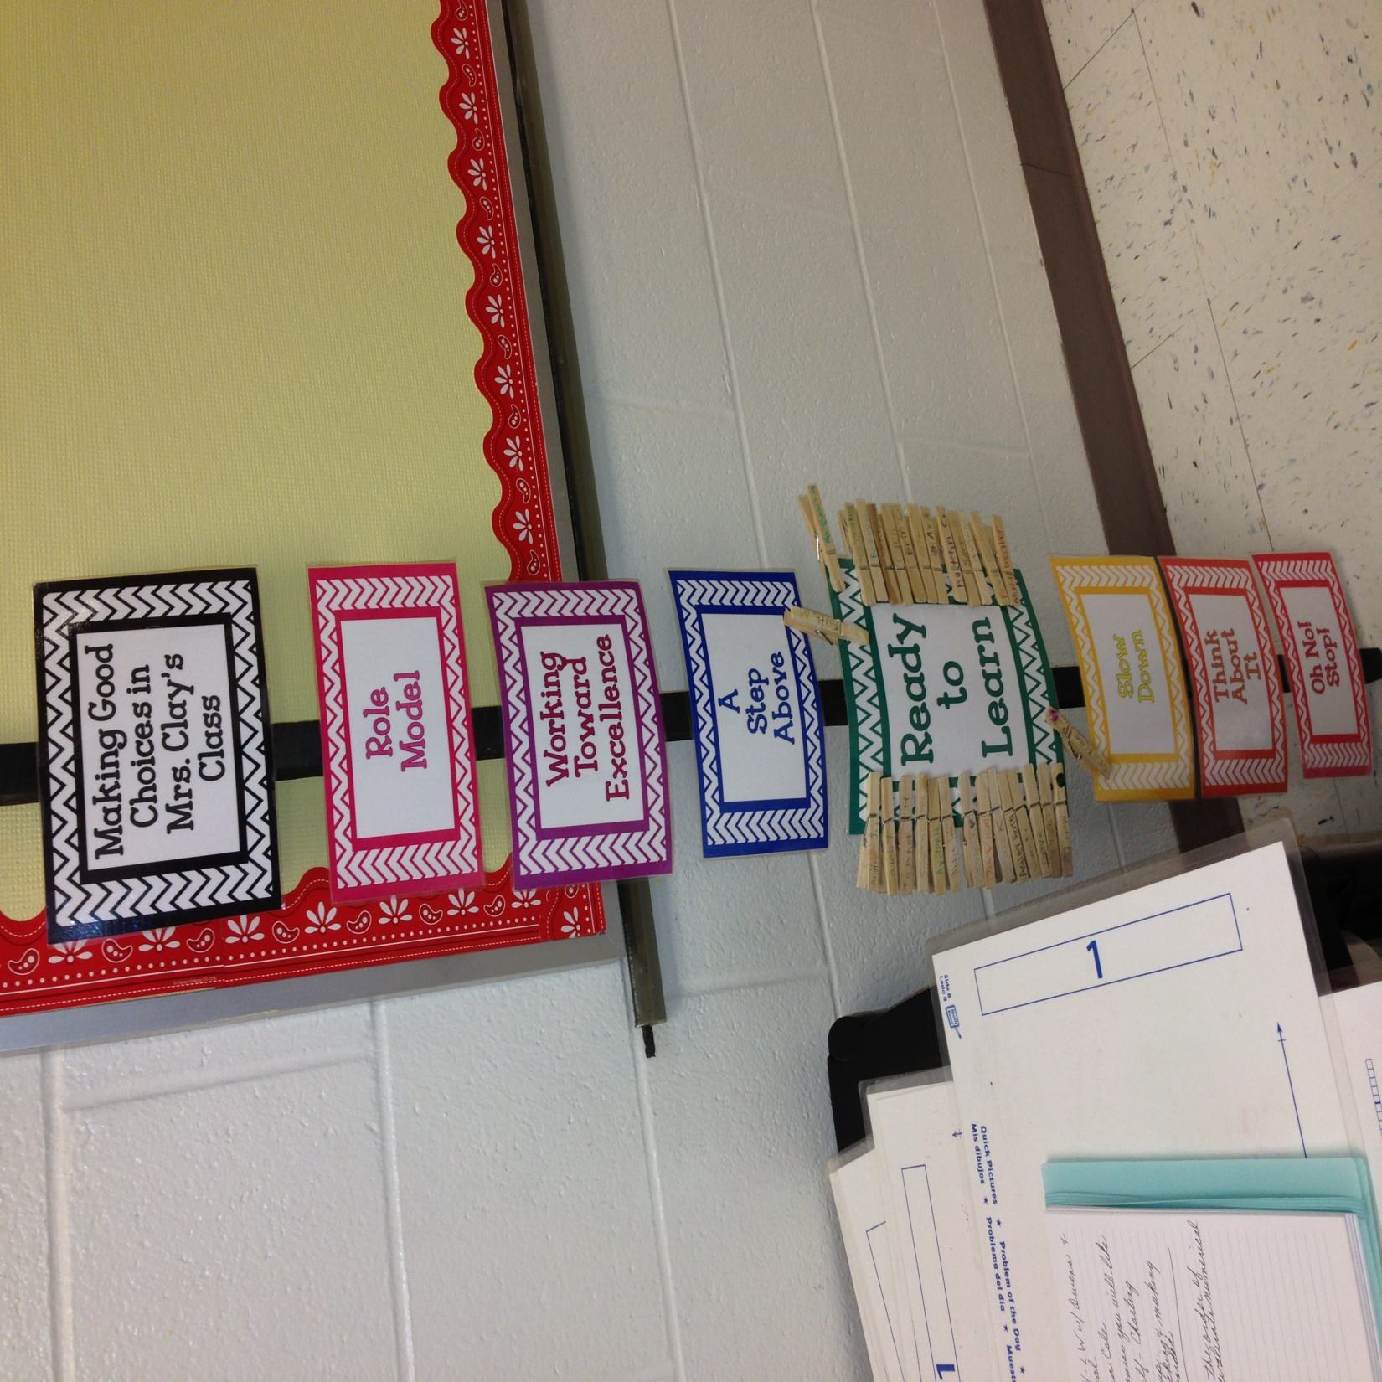
Example: Voice Level Chart

Slide 15
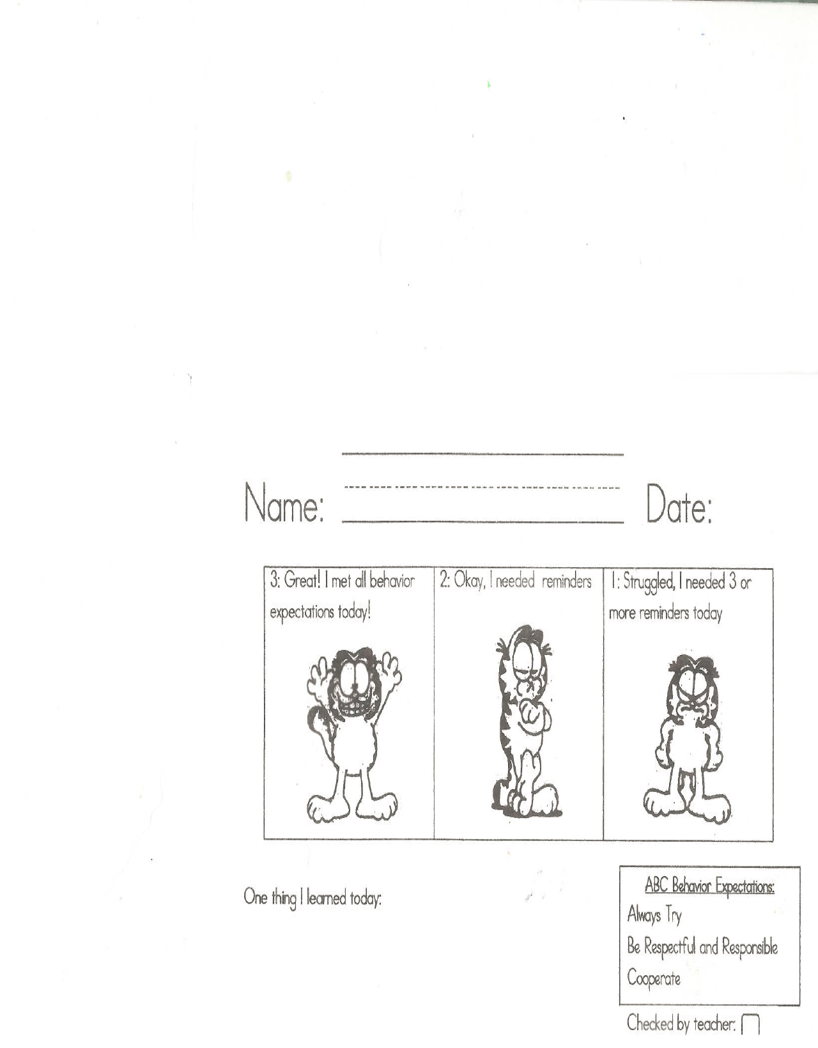
Example: Exit Slip

Slide 16
Area of Focus | Behavior Matrix for Early Learners School Wide Rules/Expectations
 | Be Safe | Be a Learner | Be a Friend
Hallway/Walking around the school
Whole Group (circle time, carpet time, etc.)
Small Group (centers, stations, etc.)

Slide 17
What The Research Says: Classroom Management
Vision – When you know where each child in your room is developmentally, and where you are headed, you will be more successful in guiding children to success.
Organization – When you have well-organized routines and procedures for your classroom, you motivate children to participate, become engaged, and do their best.
Expectations - When your expectations are clear, students never have to guess how you expect them to behave.
Correcting Misbehaviors – When you treat a child’s misbehavior as an instructional opportunity, you give the child an opportunity to learn from their mistakes.

Slide 18
The DCPS Classroom Management Checklist
Classroom Structure and Predictability
Implementation of Strategies
Engagement
Strategies to Respond to Appropriate Behaviors
Strategies to respond to Inappropriate Behaviors
Task Design
Notes:
Turn to the page _____ in your booklet.

Slide 19
Structure and Predictability
Daily Schedule – Arrange your daily schedule so that it maximizes your instructional time and responsible behavior and minimizes wasted time and irresponsible behavior
Why this works:
  Student Engagement
  Student Sustained Attention
  Student Visual Model

Slide 20
Steps for Developing a Daily Schedule
Determine the set routines/activities over which you have no control (i.e. arrival, lunch, departure)
Place these activities in order of the time of day each occurs. Then look at filling in all of the gaps in the schedule with activities you consider priorities (i.e. center time, small group, class meeting)
Have lower priority activities handy as time permits.
Implement schedule and use it to manage transitions and eliminate down time.

Slide 21
Daily Schedule Tips
Make sure you have a reasonable BALANCE among the types of activities (i.e. teacher-directed/child-initiated, quiet/active, independent, etc.) used within and across the activities.
Within each learning activity, avoid any one type of task to run overly long.
Immediately following a gross motor activity, use a quiet and less stimulating activity.
Plan for engaged time during arrival, meal time, and departure.

Slide 22
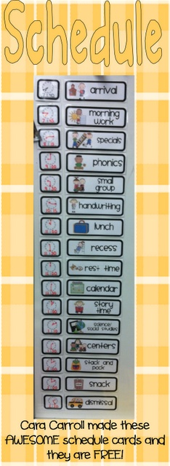
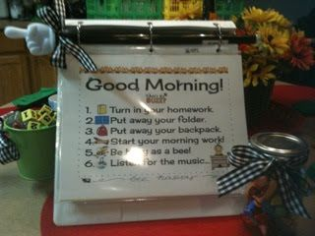
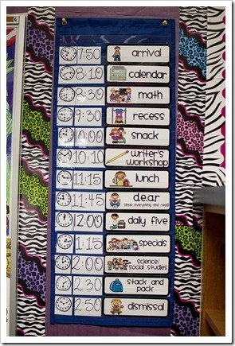
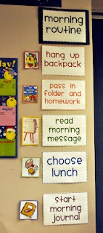
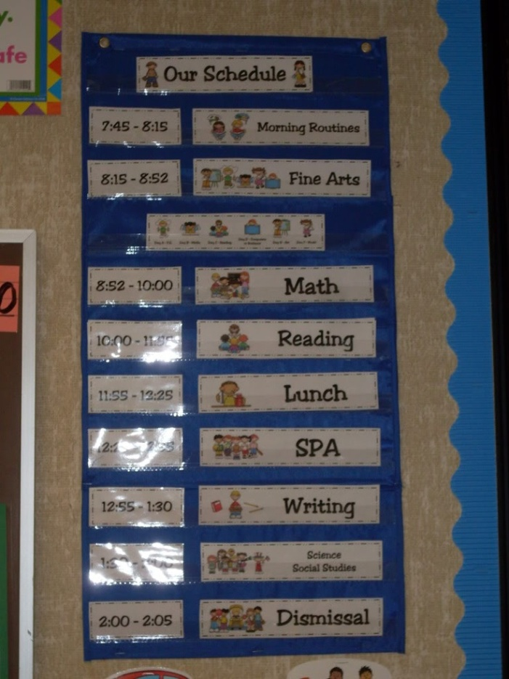
Daily Schedule Examples
http://pinterest.com/leishashigenaga/classroom-schedule-routines/

Slide 23
Activity 2
Work with your colleagues to discuss your daily schedule
Note how you will DEVELOP or MODIFY your daily schedule to make it work better for you
If your daily schedule is working well, look at the resources provided to you to see if you can identify examples that will help you to improve how you implement your daily schedule.
Notes:
Refer to page ______

Slide 24
MAC – Group Activity
Movement
Activity
Conversation
Level 2

Slide 25
Time your activities
www.online-stopwatch.com

Slide 26
Implementation of Strategies
Teaching Expectations – When you take time to explicitly teach behaviors to students, you dramatically reduce misbehaviors.
Why This Works -
  If the expected behaviors are not taught, students have to guess at how to behave.
  What students NEED to know:
    What are we doing?
    Where should I be?
    Can I talk?

Slide 27
Steps for Developing Expectations
Clearly define for yourself what you expect for all students for each activity.
Determine how you will communicate your expectations to students: Visually and Orally
Teach your students your expectations. (Use Mastery Instruction)
Provide feedback and celebrations.

Slide 28
Expectations Tips
Prepare Expectations for:
  Classroom Activities (Centers, Calendar, Reading, etc)
  Common Areas (lunchroom, playground, bus, etc)
  Transitions (within the classroom as well as between settings)
  Develop lesson plans to teach your expectations

Slide 29
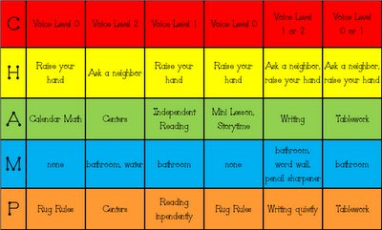
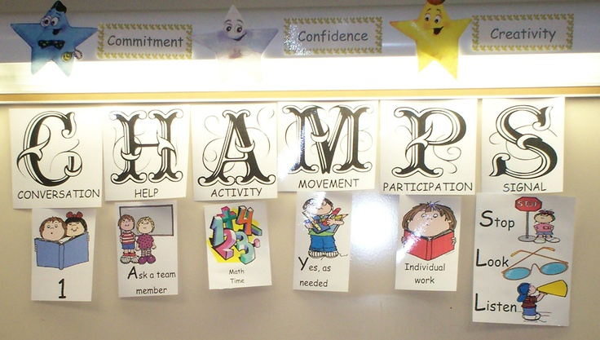
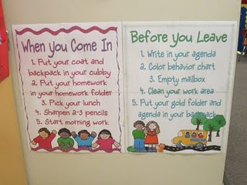
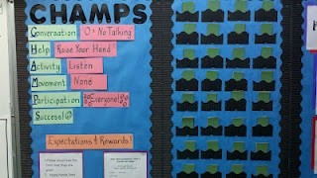
Expectations Examples

Slide 30
MOVEMENT
For Each Activity Teach MAC
ACTIVITY
After Each Activity Provide Feedback
CONVERSATION

Slide 31
Expectations Examples
 | Hallways | Restrooms | Playground | Cafeteria Lunch | Arrival/ Dismissal | Assemblies | Cafeteria Breakfast | Gym AM
R | - Right Hand Procedures - Hands, feet, and object to self | - Take care of business and leave - Put trash in trashcan | - Keep the equipment in good shape - Watch for adult signal | - Keep food on your plate - only touch your food | - Right Hand Procedures - Keep back packs safe | - Use restroom BEFORE assembly - Obey “Give me Five” | - Arrive as early as possible - Eat and leave | - Keep feet still - Obey “Give me Five”
O | - Friendship skills - Kindness - Polite | - Treat everyone kindly - Don’t hog sink, toilet, or mirror | - Try new games - Make new friends - Kind to other | - Be kind to those at your table - Include everyone | - Friendship skills - Do not exclude anyone | - Be a friend to whomever is seated near you - Use manners | - Thank the workers - Be a friend - Don’t exclude anyone | - Be a friend to others - Include others - Use manners
A | - Walk - No Horseplay | - Walk - Hands and objects to self | - Run only in grassy area - Use equipment as intended | - Walk - Be careful with trays - Keep floors clean | - Walk - No Horseplay | - Only use the steps to go up or down - No horseplay | - Walk Keep floors clean - Help others in need | - Only use steps to go up or down - No horseplay
R | - Quiet talk (level 2 or below) - Do not touch objects on walls | - Quiet talk (level 1 or below) - Keep floor dry - Always Flush! | - Kind words - Come when called - Share with others | - Quiet talk (level 2 or below) - Treat everyone kindly | - Quiet talk (level 2 or below) - Go to assigned area quickly | - Walk quietly on the steps - No talking when adults is addressing the school | - Do not touch other’s food - Quiet talk (level 2 or below) | - Walk quietly on steps - Quiet talk (level 2 or below)

Slide 32
MAC - Whole Group
Movement
Activity
Conversation

Slide 33
MAC – Independent Work
Movement
Activity
Conversation

Slide 34
Activity 3
Find the chart paper in the room that describes where you experience the most behavioral difficulty.
Discuss with your peers the problems and your expectations.
Create a set of expectations (as a group) to teach students the expected behaviors in that area.
Create a visual chart to teach the entire group your expectations.

Slide 35
MAC – Group Activity
Movement
Activity
Conversation
Level 2

Slide 36
Time your activities
www.online-stopwatch.com
10 min

Slide 37
BREAK

Slide 38
Student Engagement
What it is – This process involves developing procedures designed to increase the likelihood that students will be engaged in classroom activities.
Why This Works –
  When you are successful in engaging students, you get higher rates of student learning
  When you are successful in engaging students, you get lower rates of student misbehavior

Slide 39
Steps for Engaging Students
Develop activities that are high interest and developmentally appropriate.
Introduce activities in ways that stimulate children.
Pay attention to how you collect and maintain completed work.
Plan for how you encourage participation.

Slide 40
Tips for Engaging Students
If you have students who will not engage in the instruction, ask yourself the following:
  Are my materials sufficiently engaging?
  Are there enough materials for all children to have an opportunity to use them?
  Is the child too immature to engage in interactive activities successfully?
  Is the child simply too shy or afraid?

Slide 41
Examples for Engaging Students
Show and tell. You got to do something or bring something and then tell others about it. Secondary skill attainment measurement needs to be less about testing and more about show and tell performance-based assessment. Oh, and listening to other students is a lot more involving than listening to the old person in the room.
Choices. As a little kid you often got to choose - your library book, your reading buddy, your activity, the subject of your drawing. People tend to choose things that interest them and interesting things are engaging. How often do we let older students choose?
Play. Elementary teachers can make a game out of almost anything - and make just about every task feel like play. The older we get, the less we get to play and more we have to work. Just why is that? Gamification is a fancy term for putting play back into the curriculum. Look it up.
Naps. Most adolescents I know are tired - and not because they've been up all night texting. (Well, maybe that's part of it.) We've long known that teens do better when school starts later in the morning. Tired people have a tough time staying engaged.
To go outside. The best learning takes place in the "real world" not in the classroom. Whether it is studying bugs and leaves in first grade, marching with the band in junior high, or doing service learning as seniors, we all are more interested when it is the real world with which we are dealing.
Colors. A blank sheet of construction paper and some crayolas have always let young learners be creative. Creativity is inherently engaging. What's the high school classroom's equivilant to scissors and paste?
To do it together. Reading groups. Play groups. Science groups. It's better with other kids. Social learners are engaged learners.
Reading for enjoyment. Our elementary teachers and librarians want us to practice reading so much they let us read what we like! Do our secondary teachers want us to write so much, know so much, experiment so much, and solve problems so much that we get to do it for enjoyment?
Learning that's important. Nobody needs to convince a little kid that learning to read, to add and subtract, or to know about firemen is important. And that you should pay attention when being taught these things. Calculus, world history, the Romantic poets, the atomic structure of non-metals, not so much. If you can't convince me what you are teaching should be important to me, teach something that is.
Care. OK, this should have been the first one. I really believe a lot little kids are engaged because they know someone cares that they are. Yeah, the littlies are cute and cuddly and all that, but the gangly, awkward, homely teens need to know adults care too. When someone else is paying attention to you, you pay more attention yourself.
Notes:
Turn to page _____.

Slide 42
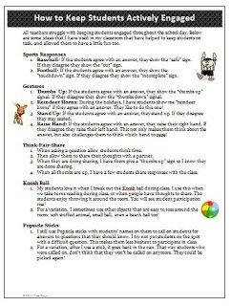
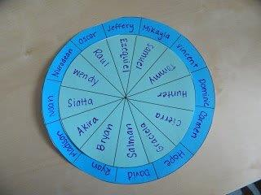
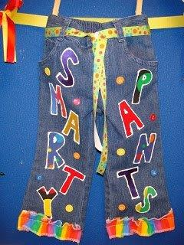
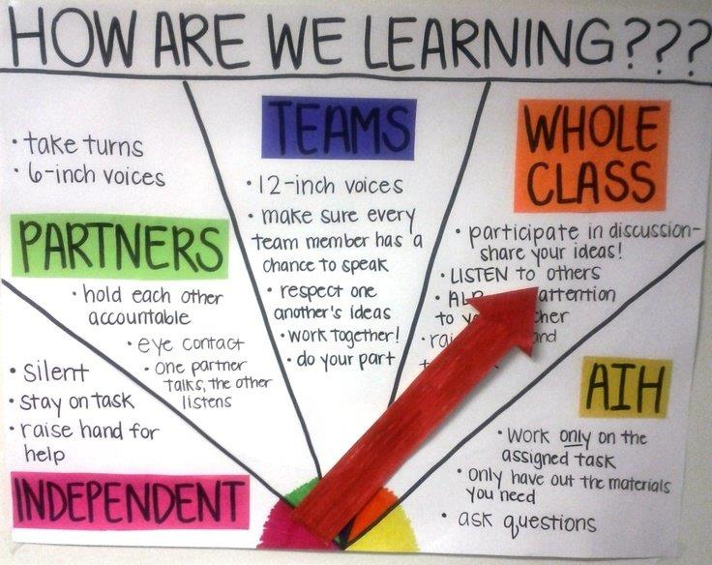
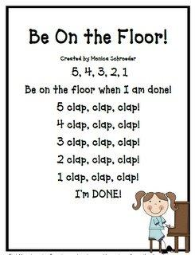
Student Engagement Examples

Slide 43
Activity 4: Student Engagement
Follow the link on Engagement
http://dcpschriswesterfield.weebly.com/pbis-activity-survey.html
How have we done in engaging you as a learner today?

Slide 44
MAC – Independent Work
Movement
Activity
Conversation

Slide 45
Time your activities
www.online-stopwatch.com

Slide 46
Lunch

Slide 47
Video
http://www.youtube.com/watch?v=qy_mIEnnlF4

Slide 48
Responding to Appropriate Behavior
What is it? When you deliberately work on building positive relationships with each child, you motivate them to participate, become engaged, and do their best.
Why It Works?
  You get what you pay attention to.
  The more time you spend redirecting or correcting misbehavior, the more misbehavior you get.
  The more time you spend acknowledging and encouraging appropriate behavior, the more positive behavior you will get.

Slide 49
Steps for Responding to Appropriate Behavior
Pay attention to your ratios of interactions and try to maintain at least a 4:1 ratio of positive to negative interactions.
For difficult to reach children, find ways to interact with them in non-contingent ways.
Give frequent positive feedback in a variety of ways in regards to each child’s progress/success in meeting academic and behavioral goals.
Periodically reward both individual children as well as the entire class with celebrations designed to acknowledge progress/success.

Slide 50
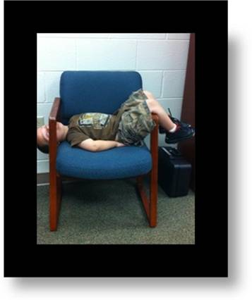
“I’ve Had Enough!!!!”

Slide 51
Tips for Responding to Appropriate Behavior
The more difficult the child’s behaviors, the higher your ratios of interactions will need to be to have a positive effect.
Frequent small celebrations have a more positive effect than fewer large celebrations.
Positive feedback needs to be given in developmentally appropriate ways that are likely to have an impact on the individual child (i.e. private vs. public).
Remember: “If I come to your classroom, do everything you ask me to do, and behave appropriately, there is a high likelihood that I will ….”

Slide 52
Examples – Responding to Appropriate Behaviors
Use social reinforcers (smiles, praise, pat on the back, wink, OK sign) and activity reinforcers (engaging in a special activity as a reward for desired behavior). Tangible reinforcers (stickers, stars, prizes) should be used only for short periods of time when other types of reinforcement fail to work with a particular child.
Use effective praise: praise that is selective, specific, and positive.
Remember…
Get to Know and Demonstrate a Personal Interest in your Students
Acknowledge and Praise Students
Be Aware of your Nonverbal Communication

Slide 53
Activity 5 – Responding to Appropriate Behaviors
Take some time to discuss with your colleagues how paying attention to your ratios of interactions can impact your classroom.
Discuss ways that you can increase your ratios of interactions:
  For the entire class.
  For an individual child.
  During a particularly difficult time of day.

Slide 54
MAC – Group Activity
Movement
Activity
Conversation
Level 2

Slide 55
Responding to Inappropriate Behavior
What is it? Ignoring misbehavior will not cause the misbehavior to go away. Only instruction on how to use a different behavior will cause misbehavior to go away.
Why it works?
  You get what you pay attention to.
  The more time you spend redirecting or correcting misbehavior, the more misbehavior you get.
  The more time you spend acknowledging and encouraging appropriate behavior, the more positive behavior you will get

Slide 56
Steps for Responding to Inappropriate Behaviors
Determine WHY the child is behaving the way that they are.
Make sure the child is set up for success rather than failure by assuring that the activities are developmentally appropriate.
Make environmental modifications if possible to avoid future problems.
Find ways to assure that the child has opportunities to experience success at high rates.
Make sure that if the child has to be removed, the environment they are removed to is not more rewarding than the classroom.

Slide 57
Tips for Responding to Inappropriate Behaviors
These procedures are designed to help a child who is basically under control, but struggles occasionally.
If the classroom is bordering on being out of control, no behavioral intervention for an individual child is likely to be successful.
If you have a child in your classroom who has intense behavioral problems, you DO NOT have to handle it by yourself. Look for in-school and district supports!

Slide 58
Examples – Responding to Inappropriate Behaviors
Proximity Control -- Strategic placement/movement by the teacher in order to encourage positive behavior.
Touch Control -- A gentle touch on the shoulder or back of chair while moving around the room
Signal Non-verbal cue -- Non-verbal techniques include such things as eye contact, hand gestures, a handclap, finger snap, clearing one’s throat, etc.
Re-direct -- This strategy employs a very brief, clearly and privately stated verbal reminder of the expected behavior.
Re-teach -- Just as in instruction, you label the skill, teach and show, and give the student the immediate opportunity to practice by demonstrating the behavior.
Provide Choice -- This is the statement of two alternatives–the preferred or desired behavior or a less preferred choice.
Ignore/Attend/Praise -- The teacher praises an appropriately behaving student in proximity to the inappropriately behaving student.

Slide 59
Activity 6 – Responding to Inappropriate Behaviors
Talk to your colleagues about an individual child in your class who has behavioral problems that you are concerned about. (Please respect the confidentiality of the child.)
Look at the DCPS Checklist and see if there are any of the strategies on it that you are not consistently using.
See if your colleague or anyone in the room can help you to come up with a solution.

Slide 60
MAC – Group Activity
Movement
Activity
Conversation
Level 2

Slide 61
Task Design
What Is It? Carefully designing activities that meet the developmental needs of children will likely result in more student engagement and less misbehavior.
Why It Works?
  When student see no benefit in doing what you ask them to do, they will chose to do what they want to do.
  When materials and activities are not developmentally appropriate, students will not successfully engage in the activity.
  If activities are allowed to go on for too long, students will become bored and misbehave.

Slide 62
Steps for Task Design
Design creative and fun ways to teach new and difficult concepts to children.
Know your students and make sure the activities are relevant to their environment and age.
Carefully design:
  The lesson
  The materials
  Your method for providing feedback
  Your method for recording outcomes and/or observations

Slide 63
Tips for Task Design
Relationships – When students have a strong positive relationship with the teacher, they are more likely to engage in instructional activities.
Relevance – The more the activity is relevant to the life of each child, the more likely the teacher is to get every child engaged in the activity.
Rigor – When a teacher has a great relationship with every child and designs relevant activities, teachers are more successful in implementing rigorous instructional activities.

Slide 64

Examples – Task Design
Mr. York’s YouTube Video here. (Louisville Male)

Slide 65
Activity 7 – Task Design
Talk with our colleagues about how you plan for and design instructional activities.
Think about an individual student who is struggling in your classroom.
Look at the checklist and consider changes you may need to make for that child including:
  Making tasks more relevant.
  Building opportunities for choice.
  Adjusting tasks to the students’ ability level.
  Adjusting the length of time the student needs to engage in the activity.

Slide 66
MAC – Group Activity
Movement
Activity
Conversation
Level 2

Slide 67
Time your activities
www.online-stopwatch.com
5 min

Slide 68
Break

Slide 69
Intensive Behaviors in the Kindergarten Setting

Slide 70
The Comprehensive Model – The Basics
No Intensive Intervention will be successful if there are not multiple, comprehensive Universal strategies in place.
Universal and Targeted interventions will not be enough to change the behavior of an Intensive student. BUT, these interventions will usually become the basis for the intensive modifications.
The best interventions are those designed to teach the child new behaviors/skills.

Slide 71
PBIS
Positive Behavior Interventions and Supports
  Behavior RtI

Slide 72
Supports for Intensive Behaviors
DCPS Student Behavior Supports Flowchart
DCPS Classroom Management Checklist

Slide 73
Intensive Interventions
(BIP) Behavior Intervention Plan = Behavior Instruction Plan
Interventions for Triggers – Change the Environment. Increase structure. Improve predictability and routines.
Determine the Functions – WHY!! Interventions must match the NEED driving the behavior, not the symptoms of the behavior.
Interventions for Consequences – What is the child getting from the behavior?

Slide 74

Behavior INSTRUCTION Plan
Carpet time
Centers
Restroom
Reading
Math
Lunch
Playground

