Slide 1


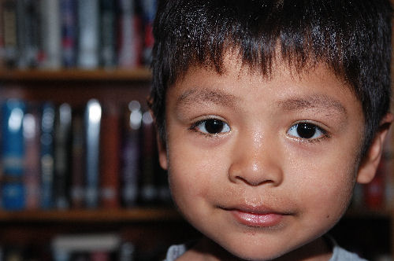
Professional Development:
Advancing Child Outcomes for all Kentucky Children
Notes:
Amanda – Thanks for participating in PD Webinar

Slide 2


Albert Fox, Director of Professional Development
Amy Hood-Hooten, WKU Early Childhood Training Specialist
Kentucky Governor’s Office of Early Childhood
Notes:
Amanda - Introductions

Slide 3

The BIG Question . . .
If you could do ONE thing to improve Early Childhood outcomes in your community, what would it be?
Notes:
Amanda – Seeing Early Childhood Education as a Statewide issue, with each individual community playing a role.

Slide 4
Our Business Model
Early Childhood Advisory Council (ECAC)
Children Enter Kindergarten Ready
High Quality Early Learning Environments
Supportive Families
Access to Data
Families understand child health and developmental needs
Common Kindergarten Entry Screener
Participation in STARS
A great early childhood workforce
Scholarships & PD Plans
Families are engaged
Children have access to appropriate services
Data is shared by early childhood programs
Notes:
Amanda – Working with community partners to develop long term PD programs will
Professional Development is one tool in the School Readiness toolbox.
Community Strategy

Slide 5
Strategies to Maximize Professional Development Dollars
With the reduced funds for Professional Development, every dollar must be used
strategically to maximize the outcomes for children across the state.
With the changes in the PD System, now is the time to build a strong community
foundation to address a part of this need!
What can CECCs do to help?
- Offer stipends for trainings
- Scholarships for students
- Host Training Days
- Align content for CDA
- Identify community needs with the Early Childhood Profiles, and focus
training and other activities on those needs
Notes:
Albert talk about reduction in funds, then to Amy for CECCs

Slide 6
Early Childhood Profiles will give guidance in addressing PD issues
Notes:
Amy -
CECCs should focus on where the state/communities are scoring lower and focus PD in those areas
Look at Early Care and Education Workforce data to determine how to better serve children and families in community

Slide 7
Ready to Grow, Ready to Learn, Ready to Succeed
Councils can utilize the Early Childhood Profile to determine where they have:
  Been successful
  Discover new opportunities
  Leverage community assets
Notes:
Both
Using Screener data to focus energies on what is scoring lowest
Less than half children in (what community) are in regulated child care

Slide 8
In the Logic Model the Core and Best Practice Pieces All Fit Together!
Screener Data
Community Priorities
Federal&
State Priorities
Needs Based Priorities
Feed back
from the
Field
Effective Delivery Systems
Core Content
TA/Coaching Credential
Child Care
Trainer Competencies
Head Start
Pre
K
CECCs
Other
Notes:
Albert

Slide 9
Who needs Early Childhood Professional Development?
Licensed Center
Employees
Family Child Care
Home Providers
Preschool Aides
Family and Consumer
Science Students
Head Start/Early Head
Start Teachers and Aides
Notes:
Amy’s points – 1, 3, 5, 7
Albert’s points – 2, 4, 6,
Licensed Center employees who must meet state regulations
Preschool Aids who are working toward a CDA (to meet NIEER benchmarks)
Family Child Care home providers who must meet state regulations
High School Family Consumer Science students who are working on resource files and assignments
Head Start/Early Head Start teachers and aides who must meet Federal and State Regulations
CECCs members who are seeking to gain more knowledge and skills within their community.
Parents who are seeking to gain more knowledge and skills to assist their children

Slide 10

Why Communities Need On-Going Professional Development
Notes:
Both
Albert’s points – 1, 3, 5, 6
Amy’s points – 2, 4, 7
STARS ratings are tied to credentials and trainings. Make sure folks know they can enhance STAR levels in homes as well
To assist School Systems that want their TA’s to reach NIEER benchmarks
To enable Licensed Centers and Family Childcare Homes opportunities to gain on-going expertise to set a professional image for their community and create quality environments for children and staff.
To encourage possible partnerships between Head Start Programs, High Quality Licensed Centers and/or preschool
To enhance STARS ratings for Licensed Centers and Family Childcare Homes
To give Opportunities for Family and Consumer Science Early Childhood high schools students to obtain community and career experience.
To ensure feeder systems of knowledgeable students for college classes.
So that ALL KENTUCKY CHILDREN will be in quality environments and Ready for School and Success!!

Slide 11
What Professional Development is Needed
State and Federal priorities
Early Childhood Profiles/Kindergarten Readiness screener data
Professional Development Plan
Notes:
Amy’s slide
Staying up to date on the State and Federal priorities will help guide you in training opportunities for your community.
By using the Early Childhood Profiles and the Kindergarten Readiness screener data, you can determine what trainings would most benefit your community.
Each provider has a Professional Development plan! Use your community partners plan and schedule PD trainings.

Slide 12
How do we find Trainers?
Child Care Aware Training Coordinators
Use community resources
  Local Training Agencies
Non-Credentialed Trainer (922 KAR 2:40 Section 16(5)
  Preschool and Head Start/Early Head Start teachers
  Family and Consumer Science Teachers
ECE-TRIS
  Visit http://tris.eky.edu/ece to see a public calendar of trainings
Cabinet for Health and Family Services
  Visit http://chfs.ky.gov/dcbs/dcc/trng_app.htm for a State Approved Training list
Notes:
Amy’s Slide –
922 KAR 2:240 Section 16(5) is the regulation for the non credentialed trainers sessions
Training Coordinators STATEWIDE?
Amy – 1, 2
Albert - 3
-NOTE: If a non-credentialed trainer is used, the training must be pre-registered
With the Division of Child Care in order to count for clock hours for licensing,
Certification , or credentialed renewal hours. The exception would be any
in-service training for school employees
These potential additional trainers could be an important consideration as
Communities review their Early Childhood Profiles in order to advance child outcomes,
In offering training that builds upon content and knowledge
-Such a system would also serve as an opportunity to coordinate, energize, and
Invigorate the field by building relationships among all those who work within the
Early care and education community.
. CECCs can recruit preschool, Head Start Teachers, Family and Consumer Science
Teachers and others to assist with these trainings
2. Give potential trainers an opportunity to grow their skill before they apply for a
Credential.
- Some presenters might want to present one hour each and a flip chart
with another presenter for a total of two hour trainings
3. Councils should organize trainings under the umbrella of an organization such as
Head Start, the school System, college or resource and referral organization, so
Hours will count toward the 120 hours needed for a direct assessment CDA

Slide 13
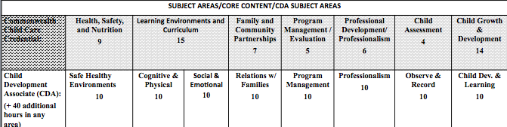

Kentucky Core Content/CDA Subject Areas
Notes:
Albert – CDA requirements
Amy – Core Content for KY
Be purposeful when planning trainings and use hour strategically. If you plan your trainings carefully, you can raise the number of CDAs in your community

Slide 14
Finally… Remember
On-Going Professional Development requires time, knowledge, and planning to
meet your communities needs
Plan trainings strategically to promote CDA credential
Working together we can do more with less!
Each community is different and will require INDIVIDUALIZATION and time to build
an on-going system
Professional development is one part of an over all outcome strategy to increase
School Readiness in Kentucky.
Notes:
Amy points – 1, 2, 3
Albert – 4
Amanda – 5

Slide 15
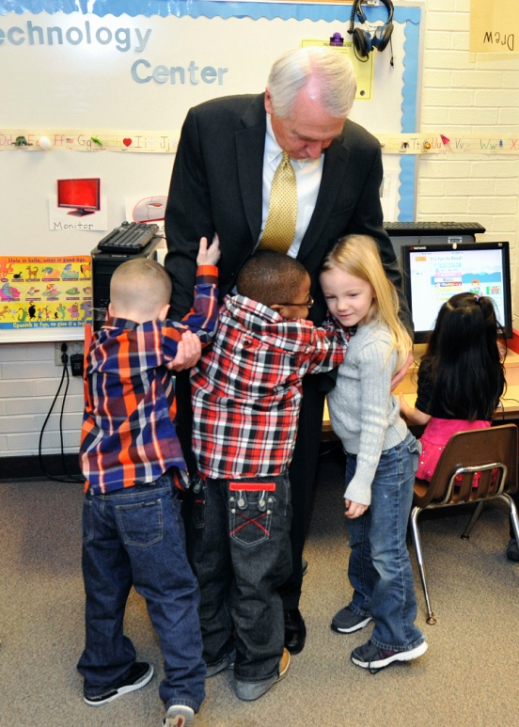
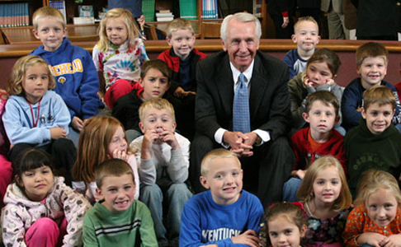
Governor’s Office of Early Childhood
125 Holmes St.
Frankfort, KY 40601
502-782-0200
You Make the Difference!
Thank You!

