Slide 1
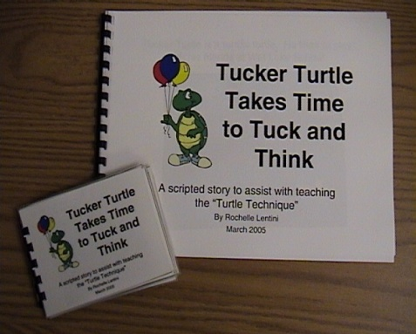
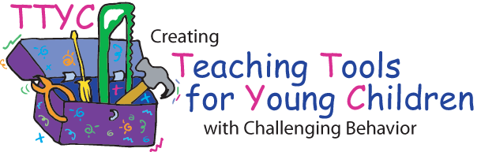
Tucker Turtle Takes Time to Tuck and Think
Scripted Story Tips
For tips and guidelines about “Scripted Stories”, please begin by reading “Scripted Stories for Social Situations Tips” located in the Scripted Stories folder on your CD.
This story is intended to be used in conjunction with the “Turtle Technique” (see file on CD). For additional guidance on how to help children with anger control, please read the article provided on your CD called “Helping Young Children Control Their Anger and Handle Disappointment”.
Please note that you can use real photographs with the line drawings for children that need this level of support (see Visual Strategies Folder 5 on CD). For instance, next to the line drawings, you can glue or Velcro a photograph of a child making an angry face, a child who is upset, children who are happy, etc.
Assembly Directions:
After printing on cardstock paper (or printer paper glued to manila file folder for increased durability), bind the edge to form a book. If the book will be handled by the child, it might be helpful to laminate the pages prior to binding to increase durability. See next page(s) for “printing directions”.
Lentini, R., Vaughn, B. J., & Fox, L. (2005). Teaching Tools for Young Children
with Challenging Behavior. Tampa, Florida: University of South Florida,
Early Intervention Positive Behavior Support.

Slide 2
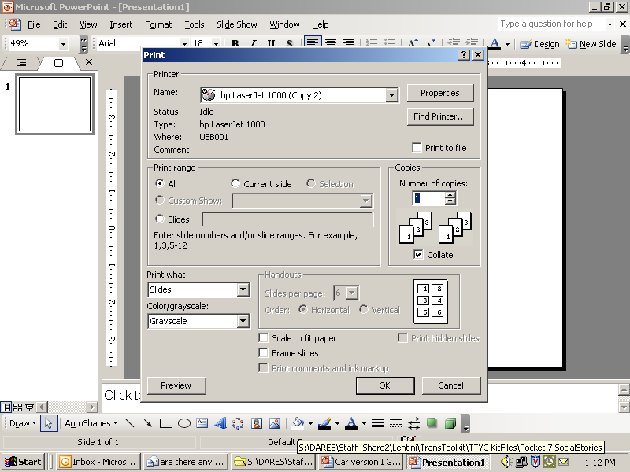

PRINT DIRECTIONS FOR FULL SIZE BOOK
Step 1:
Click on File & select Print
Step 2:
Select slides to print story
Type 4-19
Step 4:
Type # of copies
Step 3:
Select “slides”
Step 5:
Click OK
Lentini, R., Vaughn, B. J., & Fox, L. (2005). Teaching Tools for Young Children
with Challenging Behavior. Tampa, Florida: University of South Florida,
Early Intervention Positive Behavior Support.

Slide 3
PRINT DIRECTIONS FOR SMALL SIZE BOOK
Step 1:
Click on File & select Print
Step 2:
Select slides to print story
Type 4-19
Step 5:
Type # of copies
Step 4:
Select “2” slides per page
Step 3:
Change slides to
“handouts”
Step 6:
Click OK
Lentini, R., Vaughn, B. J., & Fox, L. (2005). Teaching Tools for Young Children
with Challenging Behavior. Tampa, Florida: University of South Florida,
Early Intervention Positive Behavior Support.

Slide 4
Tucker Turtle Takes Time to Tuck and Think
A scripted story to assist with teaching the “Turtle Technique”
By Rochelle Lentini
March 2005
Lentini, R., Vaughn, B.J., & Fox, L. (2005). Teaching Tools for Young Children with Challenging Behavior. University of South Florida.
Created using pictures from Microsoft Clipart® and Webster-Stratton, C. (1991). The teachers and children videotape series: Dina dinosaur school. Seattle, WA: The Incredible Years.

Slide 5
Tucker Turtle is a terrific turtle. He likes to play with his friends at Wet Lake School.

Slide 6
But sometimes things happen that can make Tucker really mad.

Slide 7
When Tucker got mad, he used to hit, kick, or yell at his friends. His friends would get mad or upset when he hit, kicked, or yelled at them.

Slide 8
Tucker now knows a new way to “think like a turtle” when he gets mad.
Step 1

Slide 9
He can stop and keep his hands, body, and yelling to himself!
STOP
Step 2

Slide 10
He can tuck inside his shell and take 3 deep breaths to calm down.
Step 3

Slide 11
Tucker can then think of a solution or a way to make it better.
Step 4

Slide 12
Tucker’s friends are happy when he plays nicely and keeps his body to himself. Friends also like it when Tucker uses nice words or has a teacher help him when he is upset.

Slide 13
The End!

Slide 14
Teacher Tips on the Turtle Technique
Model remaining calm
Teach the child the steps of how to control feelings and calm down (“think like a turtle”)
  Step 1: Recognize your feeling(s)
  Step 2: Think “stop”
  Step 3: Tuck inside your “shell” and take 3 deep breaths
  Step 4: Come out when calm and think of a “solution”
Practice steps frequently (see cue cards on next 4 pages)
Prepare for and help the child handle possible disappointment or change and “to think of a solution” (see list on last page)
Recognize and comment when the child stays calm
Involve families: teach the “Turtle Technique”
Webster-Stratton, C. (1991). The teachers and children videotape series: Dina dinosaur school. Seattle, WA: The Incredible Years.

Slide 15
Step 1

Slide 16
STOP
Step 2

Slide 17
Step 3

Slide 18
Step 4

Slide 19
Help the Child Think of a Possible Solution:
Get a teacher
Ask nicely
Ignore
Play
Say, “Please stop.”
Say, “Please.”
Share
Trade a toy/item
Wait and take turns
Etc.
Lentini, R., Vaughn, B. J., & Fox, L. (2005). Teaching Tools for Young Children
with Challenging Behavior. Tampa, Florida: University of South Florida,
Early Intervention Positive Behavior Support.

