Slide 1
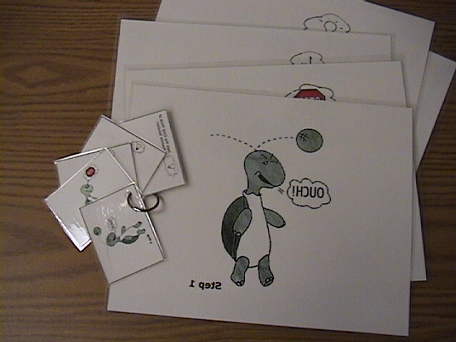
Turtle Technique
The “Turtle Technique” is a technique for helping children with controlling anger (see next slide for steps to teach). This technique can be used in conjunction with the scripted story, “Tucker Turtle Takes Time to Tuck and Think” (see file on CD). For additional guidance on how to help children with anger control, please read the article provided on your CD called “Helping Young Children Control Their Anger and Handle Disappointment”.
Assembly Directions:
Print the pictures on cardstock (or printer paper and glue to manila folder to increase durability) and laminate the “full size” cues. For the “key ring” cues (see photograph below), first laminate and then punch holes in the corners of the picture cues and attach to the coiled bracelet key ring. The key ring can then be worn on the teacher’s wrist for quick access when individually prompting children. Printing directions are on slides 3 and 4.
Lentini, R., Vaughn, B. J., & Fox, L. (2005). Teaching Tools for Young Children
with Challenging Behavior. Tampa, Florida: University of South Florida,
Early Intervention Positive Behavior Support.

Slide 2
Turtle Technique
Model remaining calm
Teach the child the steps of how to control feelings and calm down
Step 1: Recognize your feeling(s)
Step 2: Think “stop”
Step 3: Go inside your “shell” and take 3 deep breaths
Step 4: Come out when calm and think of a “solution”
Practice steps frequently
Prepare for and help the child handle possible disappointment or change
Recognize and comment when the child stays calm
Involve families: teach the “Turtle Technique”
Webster-Stratton, C. (1991). The teachers and children videotape series:
Dina dinosaur school. Seattle, WA: The Incredible Years.

Slide 3
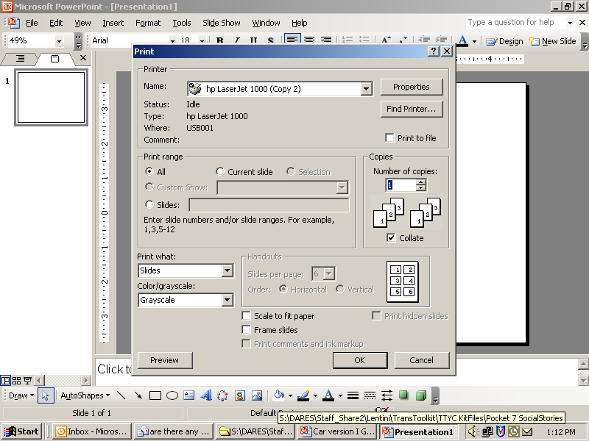
PRINT DIRECTIONS FOR FULL SIZE CUES
Step 1:
Click on File & select Print
Step 2:
Select slides to print cues
Type 5-9
Step 4:
Type # of copies
Step 3:
Select “slides”
Step 5:
Click OK
Lentini, R., Vaughn, B. J., & Fox, L. (2005). Teaching Tools for Young Children
with Challenging Behavior. Tampa, Florida: University of South Florida,
Early Intervention Positive Behavior Support.

Slide 4
PRINT DIRECTIONS FOR KEY RING CUE
Step 1:
Click on File & select Print
Step 2:
Select slides to print rules
Type 4-9
Step 5:
Type # of copies
Step 4:
Select 6 slides per page
Step 3:
Select “handouts”
Step 6:
Click OK
Lentini, R., Vaughn, B. J., & Fox, L. (2005). Teaching Tools for Young Children
with Challenging Behavior. Tampa, Florida: University of South Florida,
Early Intervention Positive Behavior Support.

Slide 5
Step 1

Slide 6
STOP
Step 2

Slide 7
Step 3

Slide 8
Step 4

Slide 9
Help the Child Think of a Possible Solution:
Get a teacher
Ask nicely
Ignore
Play
Say, “Please stop.”
Say, “Please.”
Share
Trade toys/item
Wait and take turns
Etc.
Lentini, R., Vaughn, B. J., & Fox, L. (2005). Teaching Tools for Young Children
with Challenging Behavior. Tampa, Florida: University of South Florida,
Early Intervention Positive Behavior Support.

